Slide 1
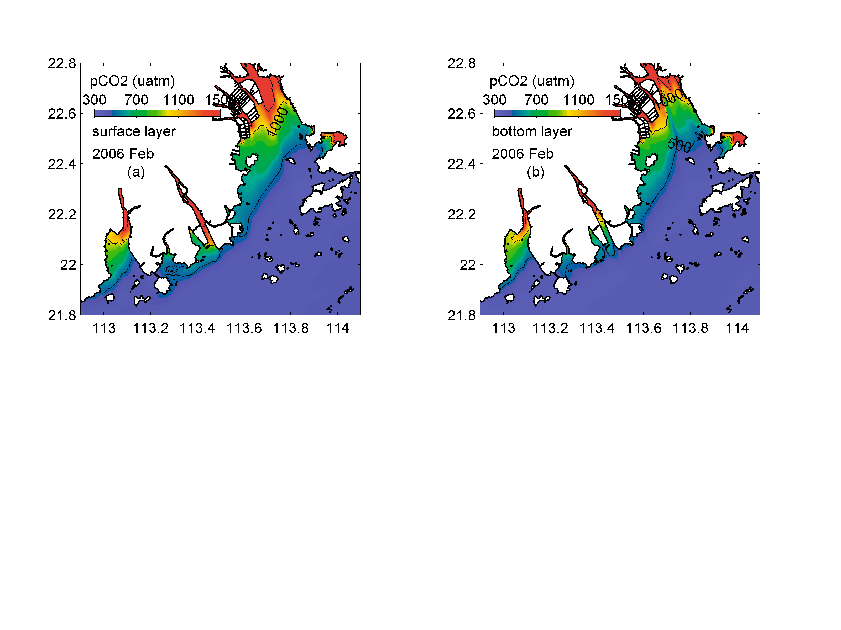
Notes:
Figure 5. Horizontal distribution of pCO₂ in winter. The left panels are the simulation results for the surface layer, while the right panels are the results for the bottom layers.

Slide 2
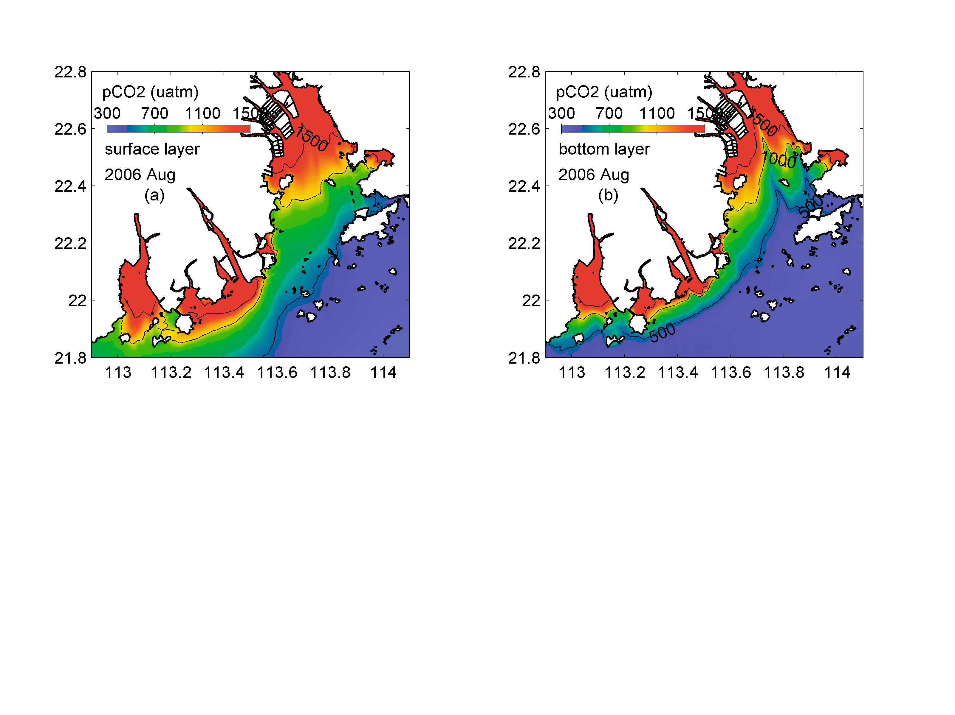
Notes:
Figure 5. Horizontal distribution of pCO₂ in summer. The left panels are the simulation results for the surface layer, while the right panels are the results for the bottom layers.

Slide 3
ILB
MLB
OLB
WFO
Notes:
Figure 5. Horizontal distribution of pCO₂ in summer (upper panels) and winter (lower panels). The left panels are the simulation results for the surface layer, while the right panels are the results for the bottom layers.

